Slide 1
Final Project – QA Cinemas
By Team Sierra;
Cameron Black
Ridwan Kawsar
Lewis Pearson
Saif Hussain

Slide 2
Scope
To create a full-stack Web application suitable for a given client specification, with utilisation of supporting tools, methodologies and technologies that encapsulate all modules covered during training

Slide 3
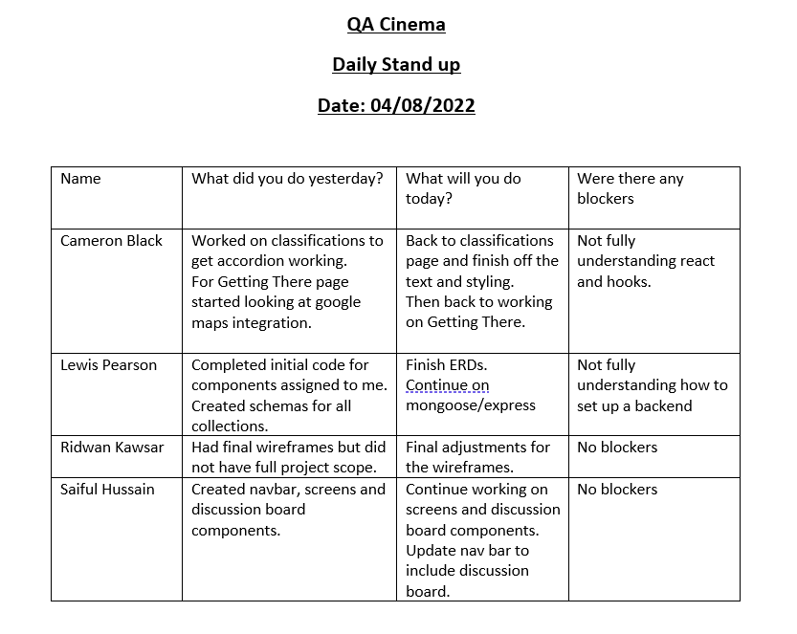
Stand-Ups

Slide 4
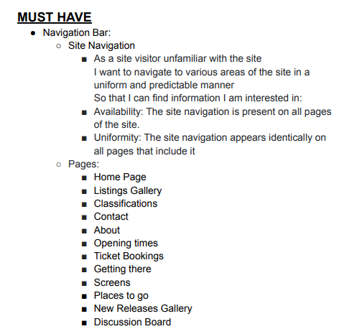
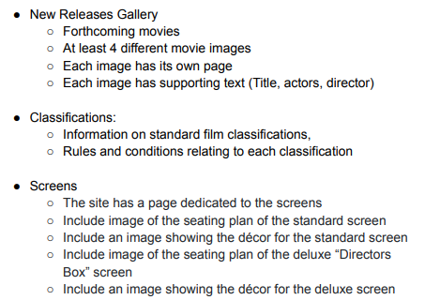
MoSCoW Prioritisation

Slide 5
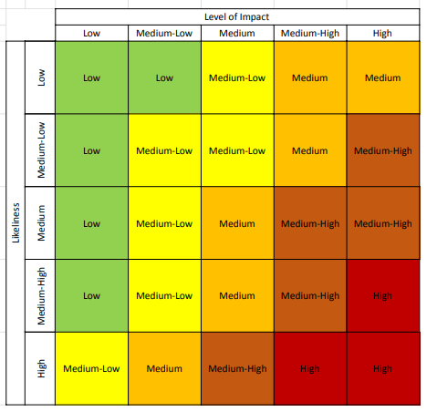
Risk Assessment Matrix

Slide 6
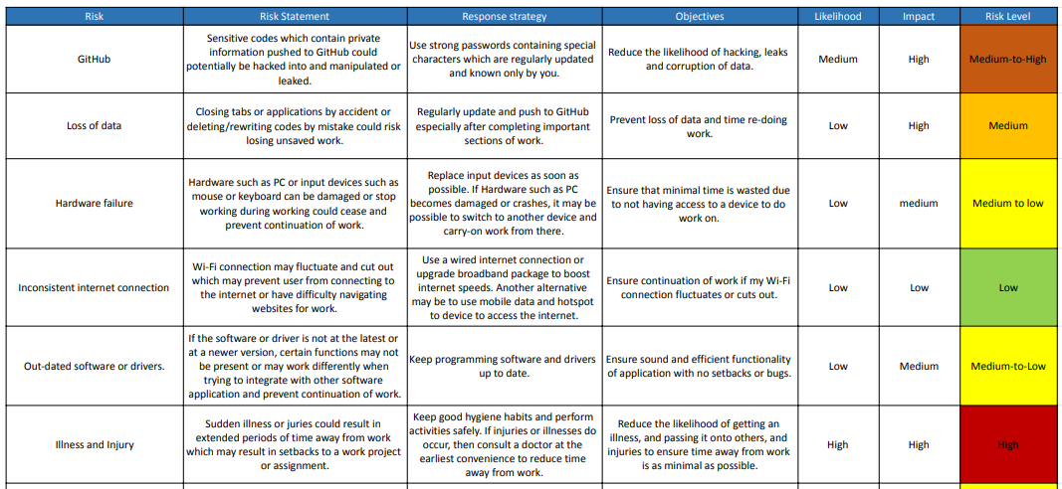
Risk Assessment

Slide 7
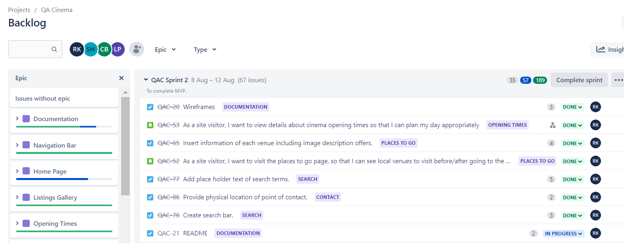
Jira – Backlog: Epics/User Stories/Tasks

Slide 8
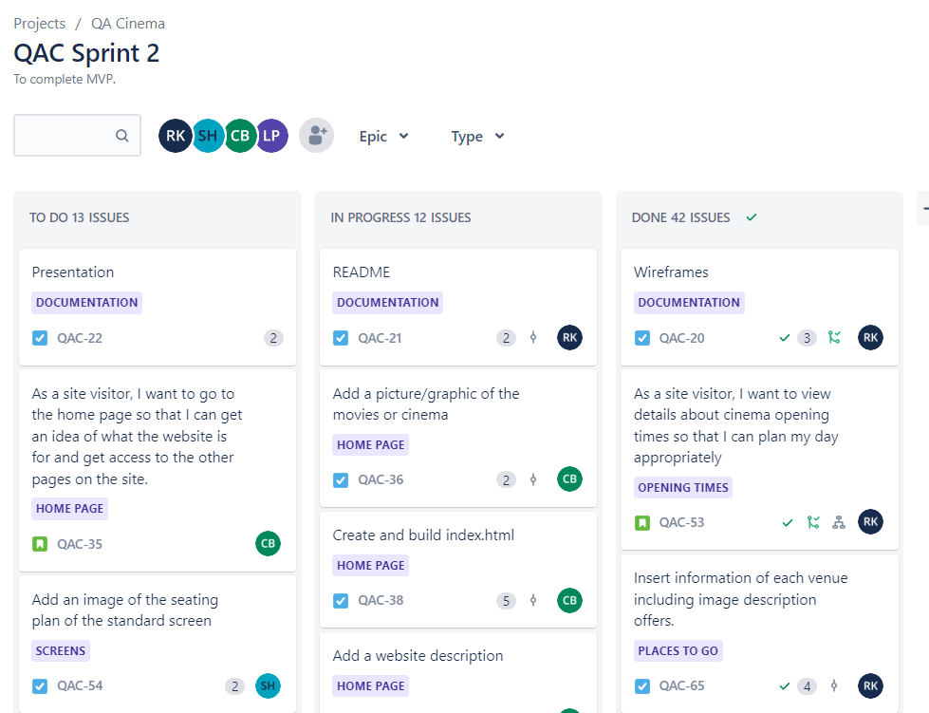
Jira Board: Sprint

Slide 9
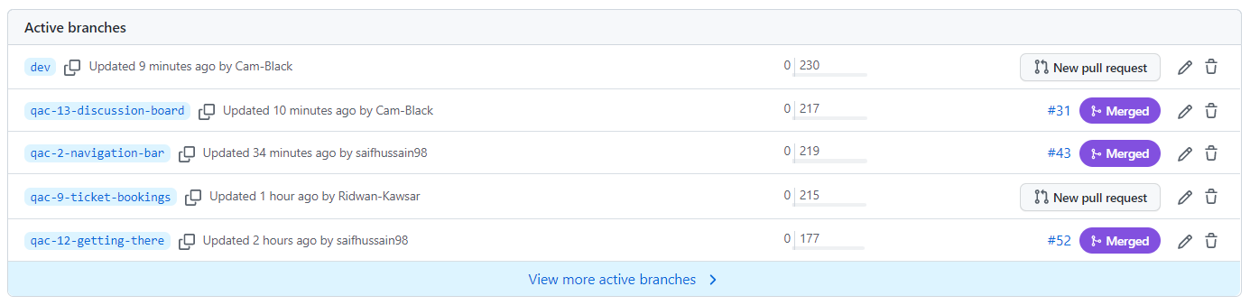
Version Control – Feature Branch Model (FBM)

Slide 10
Backend
Express; Used for web functionality.
MongoDB; Database for storing documents.
Mongoose; Connecting database to the rest of the backend.

Slide 11
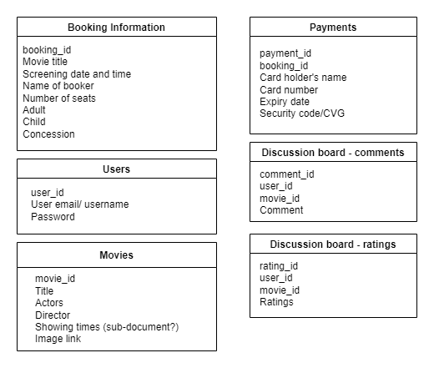
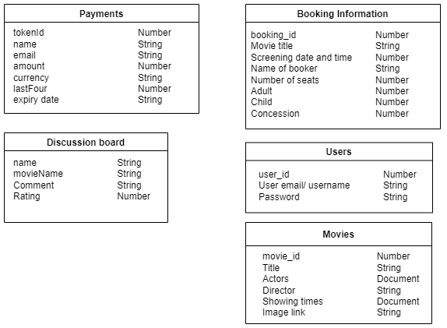
Entity Relationship Diagram (ERD) - Initial & Final

Slide 12
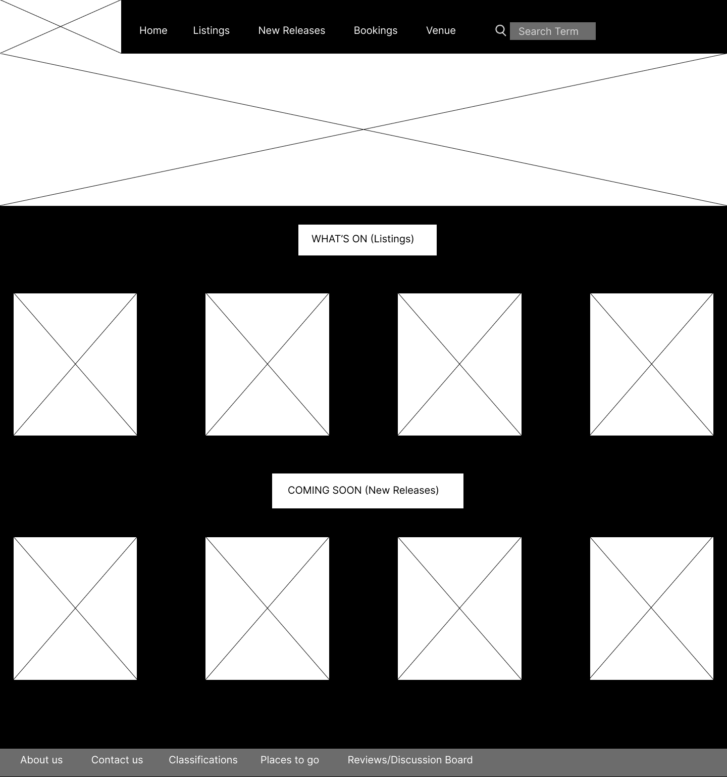
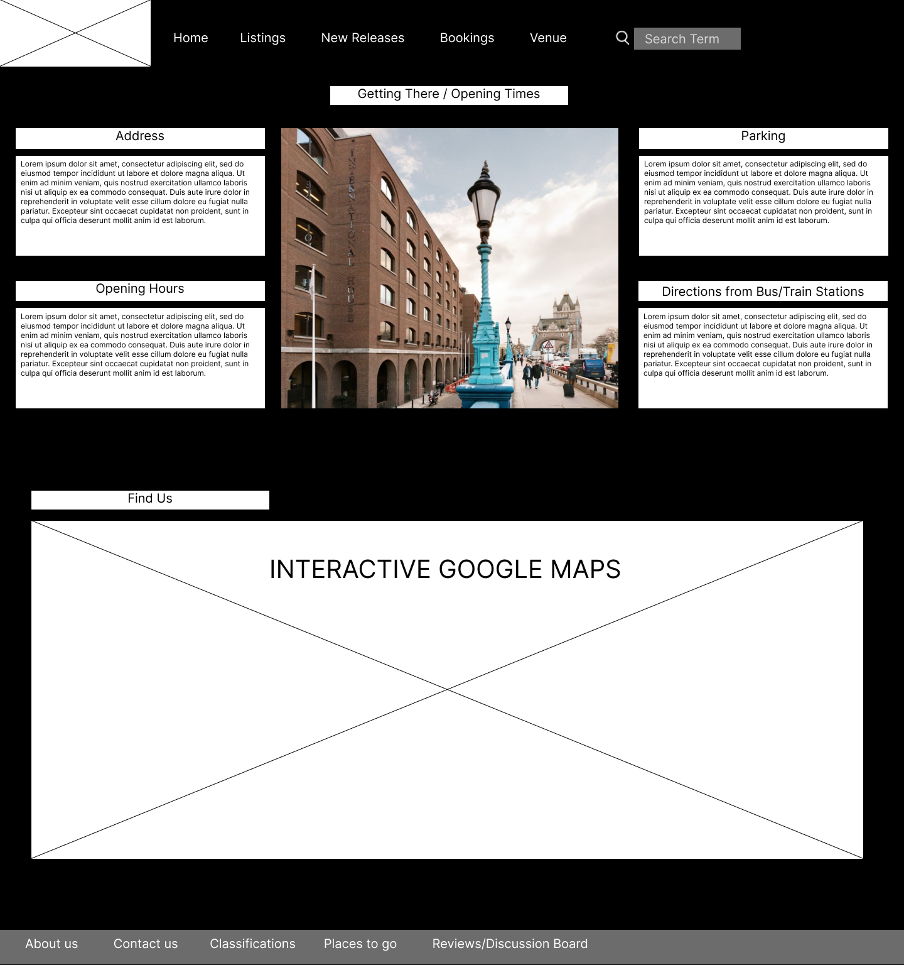
Wireframes

Slide 13

Demo

Slide 14

Any Questions?

